Slide 1



Growth mind-set through Resilient Intelligent Technologies
Funded by the European Union. Views and opinions expressed are however those of the author(s) only and do not necessarily reflect those of the European Union or the European Education and Culture Executive Agency (EACEA). Neither the European Union nor EACEA can be held responsible for them.

Slide 2

What does Third Mmission of university really mean?

Slide 3
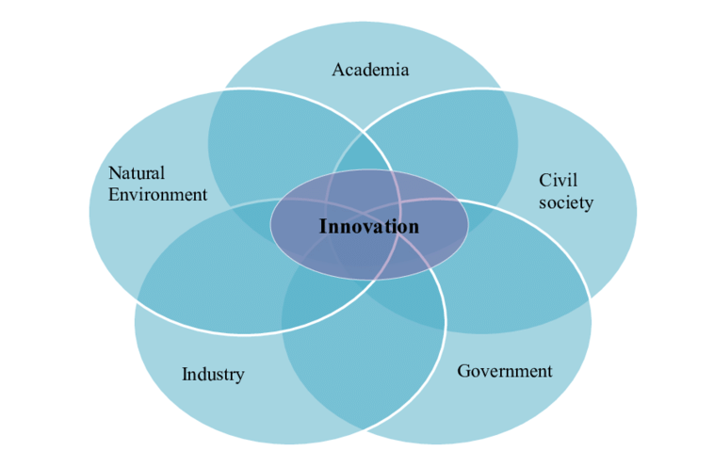
The Quintuple Helix Model provides a framework for universities to engage in open innovation by collaborating with industry, government, civil society, and the natural environment.
By embracing this approach, universities co-create innovative solutions that address societal challenges and promote sustainable development in the attempt to continue facing major societal challenges related to the complexity of issues such as climate changes, sustainability, pandemic crisis, challenges of democratic cultures, citizens’ well-being, and social justice.
(Henry Etzkowitz and Loet Leydesdorff)
The Quintuple Helix Model

Slide 4

Academic
Mission
The Academic Mission (didactic and research) needs to focus on the way academic communities interact both internally and with the external context. Moving from an Entrepreneurial University to a Transformative University in a complex society prefigures a changing paradigm of what we call the Academic Third Mission and how universities respond to what society expects from the outcomes of academic activities.

Slide 5

Third Mission
Aligning Institutional Third Mission under a shared mindset for educators, staff, researchers, academic students, and stakeholders is a pivotal objective to achievinge a Sustainable European Higher Educational System.

Slide 6

Therefore, a comprehensive, holistic, and multidimensional approach is necessary in order to well comprehend the complex set of needs and create a Transformative University.
Such a solution must provide stakeholders with a broader understanding of overall processes.
Transformative University
Professor Emeritus John Goddard express for the "University” the point of view for Social Innovation that claimed to be:
the result of an interaction between different societal sectors working towards systemic change

Slide 7

What does Third Mmission of university mean?
the Academic Third Mission refers to the idea that universities have a responsibility not only to produce and disseminate knowledge but also to contribute to the socio-economic development of their communities and the wider society.

