Slide 1



Growth mind-set through Resilient Intelligent Technologies
Funded by the European Union. Views and opinions expressed are however those of the author(s) only and do not necessarily reflect those of the European Union or the European Education and Culture Executive Agency (EACEA). Neither the European Union nor EACEA can be held responsible for them.

Slide 2

Changes suffered in our society in the past years

Slide 3
Introduction
1.1.1 Environmental Awareness and Sustainability
1.1.1.1 Increasing Urbanization
1.1.1.2 Climate Change
1
Over the past few decades, society has undergone significant changes, such as advancements in technology, economic upheavals, environmental issues, and social movements, impacting the way we live, work, and interact. To manage the complexities of our rapidly evolving world, it is vital for individuals, communities, and policymakers to comprehend and analyze these societal changes.
2
1.1.2 Changing Workforce Dynamics
1.1.2.1 Changes in the Labor Force
1.1.3 Public health
1.1.3.1 Covid-19 pandemic
1.1.3.2 Covid-19 and Economy
1.1.3.3 Covid-19 and Health and Wellness Focus
3
4
1.1.4 Digitalization
1.1.4.1 Social Media and Online Connectivity
1.1.5 Political and Geopolitical Changes
1.1.5.1 Economic Crisis (Global financial crisis)
1.1.5.2 Ukraine war
5
1.1.6 Cultural and Social Shifts
1.1.6.1 Gender Equality
1.1.6.2 LGBTQ+ Community
6

Slide 4

The great health crisis of Coronavirus (Covid-19), which was declared as a pandemic by WHO, created major economic and sociological problems and in combination with the war between Russia and Ukraine brought great changes in habits and everyday life. One of the most conspicuous and influential of these shifts has been the proliferation of social media and online connectivity. These platforms have revolutionized the way we communicate, share information, and foster virtual communities, ultimately redefining our social interactions. Moreover, there has been an escalating emphasis on social justice and equality, as an increasing number of people champion the rights of marginalized groups and demand heightened accountability from those in positions of power.

Slide 5
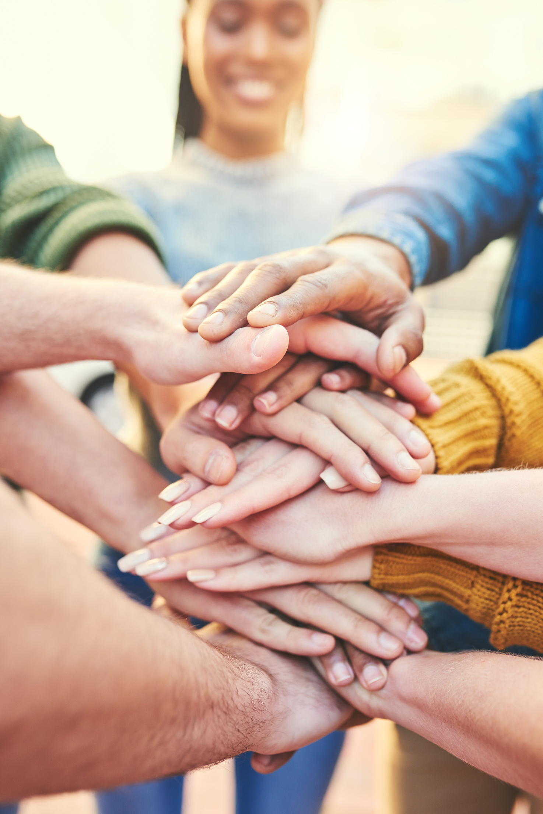
Additionally, there has been a shift towards more sustainable and environmentally conscious lifestyles, with individuals and businesses taking steps to reduce their carbon footprint and promote a more sustainable future. Overall, these changes have had a profound impact on society and will continue to shape the way people live and interact with one another in the years to come, especially with the rise of digitalization. This unit aims to provide a comprehensive understanding of the transformations that have occurred, fostering critical thinking and awareness among students.

Slide 6
Growth mind-set through Resilient Intelligent Technologies
Funded by the European Union. Views and opinions expressed are however those of the author(s) only and do not necessarily reflect those of the European Union or the European Education and Culture Executive Agency (EACEA). Neither the European Union nor EACEA can be held responsible for them.

